Slide 1
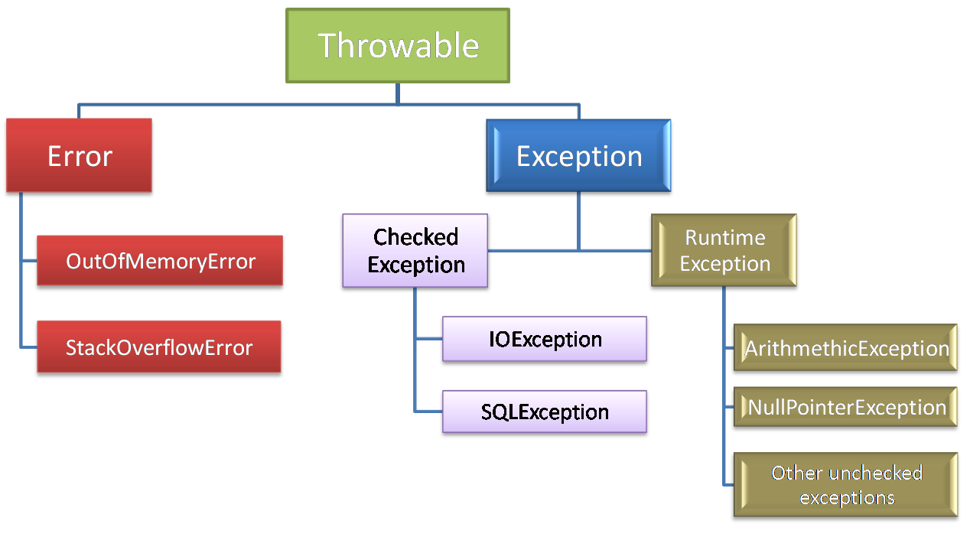
Error is considered as unchecked exception.
Error is irrecoverable e.g. OutOfMemoryError, VirtualMachineError, AssertionError etc.
Types of Exception
Unchecked exceptions are the class that extends RuntimeException.
Unchecked exception are ignored at compile time.
Unchecked exceptions are checked at runtime.
Checked exceptions are checked at compile-time.
The classes that extend Throwable class except RuntimeException and Error are known as checked exceptions e.g.IOException, SQLException etc.

